Slide 2
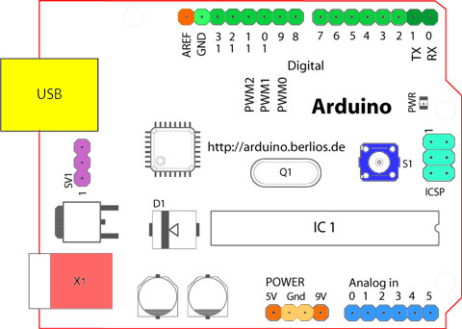

Slide 3
Analog Reference pin (orange)
Digital Ground (light green)
Digital Pins 2-13 (green)
Digital Pins 0-1/Serial In/Out - TX/RX (dark green) - These pins cannot be used for digital i/o (digitalRead and digitalWrite) if you are also using serial communication (e.g. Serial.begin).
Reset Button - S1 (dark blue)
In-circuit Serial Programmer (blue-green)
Analog In Pins 0-5 (light blue)
Power and Ground Pins (power: orange, grounds: light orange)
External Power Supply In (9-12VDC) - X1 (pink)
Toggles External Power and USB Power (place jumper on two pins closest to desired supply) - SV1 (purple)
USB (used for uploading sketches to the board and for serial communication between the board and the computer; can be used to power the board) (yellow)

Slide 4
Digital Pins
In addition to the specific functions listed below, the digital pins on an Arduino board can be used for general purpose input and output via the pinMode(), digitalRead(), and digitalWrite() commands. Each pin has an internal pull-up resistor which can be turned on and off using digitalWrite() (w/ a value of HIGH or LOW, respectively) when the pin is configured as an input. The maximum current per pin is 40 mA.
Serial: 0 (RX) and 1 (TX). Used to receive (RX) and transmit (TX) TTL serial data. On the Arduino Diecimila, these pins are connected to the corresponding pins of the FTDI USB-to-TTL Serial chip. On the Arduino BT, they are connected to the corresponding pins of the WT11 Bluetooth module. On the Arduino Mini and LilyPad Arduino, they are intended for use with an external TTL serial module (e.g. the Mini-USB Adapter).
External Interrupts: 2 and 3. These pins can be configured to trigger an interrupt on a low value, a rising or falling edge, or a change in value. See the attachInterrupt() function for details.
PWM: 3, 5, 6, 9, 10, and 11. Provide 8-bit PWM output with the analogWrite() function. On boards with an ATmega8, PWM output is available only on pins 9, 10, and 11.
BT Reset: 7. (Arduino BT-only) Connected to the reset line of the bluetooth module.
SPI: 10 (SS), 11 (MOSI), 12 (MISO), 13 (SCK). These pins support SPI communication, which, although provided by the underlying hardware, is not currently included in the Arduino language.
LED: 13. On the Diecimila and LilyPad, there is a built-in LED connected to digital pin 13. When the pin is HIGH value, the LED is on, when the pin is LOW, it's off.

Slide 5
Analog Pins
In addition to the specific functions listed below, the analog input pins support 10-bit analog-to-digital conversion (ADC) using the analogRead() function. Most of the analog inputs can also be used as digital pins: analog input 0 as digital pin 14 through analog input 5 as digital pin 19. Analog inputs 6 and 7 (present on the Mini and BT) cannot be used as digital pins.
I²C: 4 (SDA) and 5 (SCL). Support I²C (TWI) communication using the Wire library (documentation on the Wiring website).

Slide 6
Power Pins
VIN (sometimes labelled "9V"). The input voltage to the Arduino board when it's using an external power source (as opposed to 5 volts from the USB connection or other regulated power source). You can supply voltage through this pin, or, if supplying voltage via the power jack, access it through this pin. Note that different boards accept different input voltages ranges, please see the documentation for your board. Also note that the LilyPad has no VIN pin and accepts only a regulated input.
5V. The regulated power supply used to power the microcontroller and other components on the board. This can come either from VIN via an on-board regulator, or be supplied by USB or another regulated 5V supply.
3V3. (Diecimila-only) A 3.3 volt supply generated by the on-board FTDI chip.
GND. Ground pins.

Slide 7
Other Pins
AREF. Reference voltage for the analog inputs. Used with analogReference().
Reset. (Diecimila-only) Bring this line LOW to reset the microcontroller. Typically used to add a reset button to shields which block the one on the board.

Slide 8
Digital GPIO of Arduino
General-Purpose Input Output (GPIO) is a digital pin of an IC. It can be used as input or output for interfacing devices.
If we want to read switch’s state, sensor data, etc then we need to configure it as input. And if we want to control the LED brightness, motor rotation, show text on display, etc then we need to configure it as output.
Arduino Uno board has various digital IO pins which can be used for input/output devices. Following image shows the digital IO pins of Arduino Uno

Slide 9
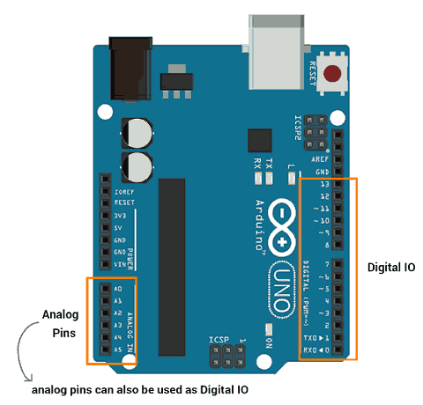

Slide 10
Digital Output
Arduino (ATmega) digital pins can be configured as output to drive output devices. We have to configure these pins to use as output.
To configure these pins, pinMode () function is used which set direction of pin as input or output.
pinMode(pin no, Mode)
This function is used to configure GPIO pin as input or output.
pin no number of pin whose mode we want to set.
Mode INPUT, OUTPUT or INPUT_PULLUP
E.g. pinMode (3, OUTPUT) //set pin 3 as output
These Arduino (ATmega) pins can source or sink current up to 40 mA which is sufficient to drive led, LCD display but not sufficient for motors, relays, etc.

Slide 11
Arduino (ATmega) digital pins can be configured as output to drive output devices. We have to configure these pins to use as output.
To configure these pins, pinMode () function is used which set direction of pin as input or output.
pinMode(pin no, Mode)
This function is used to configure GPIO pin as input or output.
pin no number of pin whose mode we want to set.
Mode INPUT, OUTPUT or INPUT_PULLUP
E.g. pinMode (3, OUTPUT) //set pin 3 as output
These Arduino (ATmega) pins can source or sink current up to 40 mA which is sufficient to drive led, LCD display but not sufficient for motors, relays, etc.

Slide 12
These pin produce output in terms of HIGH (5 V or 3.3 V) or LOW (0 V). We can set output on these pins using digitalWrite () function.
digitalWrite (pin no, Output value)
This function is used to set output as HIGH (5 V) or LOW (0 V)
pin no number of a pin whose mode we want to set.
Output value HIGH or LOW
E.g. digitalWrite (3, HIGH)

Slide 13
Digital Input
To read data from senor or from any device/circuit, we need to configure digital pin as input. Arduino pin are set as digital input (default). So, there is no need to configure pin as input.
To configure pin as digital input, pinMode () function is used. We can read data from GPIO pin using digitalRead() function.
digitalRead(pin)
It is used to read data from specified GPIO pin.

Slide 14
Blink LED Using Arduino
void setup()
{
pinMode(13, OUTPUT); // sets the digital pin 13 as output
}
void loop()
{
digitalWrite(13, HIGH); // sets the digital pin 13 on
delay(1000); // waits for a second
digitalWrite(13, LOW); // sets the digital pin 13 off
delay(1000); // waits for a second
}

Slide 15
Sequentially Turning LED ON-OF using Arduino
Let’s turn ON-OFF led sequentially. Here, first we will turn four LED ON one by one which means LED1 will ON first then LED1 and LED2 will ON and so on. When at last all four leds will get ON then turn them off in reverse sequence one by one. That means turn LED4 OFF then turn LED3 OFF and so on.
Four LED’s are connected to pin 0 – 3 of Arduino Uno.
Note: While uploading program to Arduino just remove the connection of pin 0 and 1 as they are RXD and TXD pin which are used by serial communication for program uploading. When program uploaded successfully, then connect the connection of pin 0 and 1.

Slide 16
void setup()
{
//set gpio pin {0,1,2,3} as output
pinMode(0, OUTPUT);
pinMode(1, OUTPUT);
pinMode(2, OUTPUT);
pinMode(3, OUTPUT);
}
void loop()
{
//turn LED ON one by one
for(int i=0;i<4;i++)
{
digitalWrite(i, HIGH);
delay(1000);
} //turn LED OFF one by one
for(int i=3;i>=0;i--)
{
digitalWrite(i, LOW);
delay(1000);
}
}

Slide 17
Control LED via Switch using Arduino
int pushButton = 2;
int LED = 13;
void setup()
{
// make the pushbutton's pin an input:
pinMode(pushButton, INPUT_PULLUP); //configure pin as input with pullup enabled
pinMode(LED, OUTPUT); //configure pin as output
}
void loop()
{ // read the input pin:
int buttonState = digitalRead(pushButton);
digitalWrite(LED, (!(buttonState))); //turn led on when switch pressed
delay(1); // delay in between reads for stability
}

Slide 18
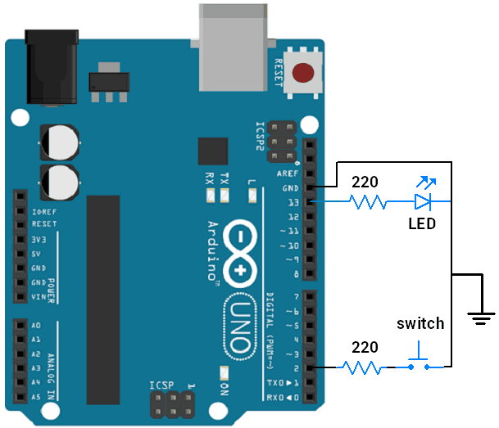

Slide 19
[Analog I/O]
analogRead()
Reads the value from the specified analog pin. Arduino boards contain a multichannel, 10-bit analog to digital converter.
This means that it will map input voltages between 0 and the operating voltage(5V or 3.3V) into integer values between 0 and 1023.
On an Arduino UNO, for example, this yields a resolution between readings of: 5 volts / 1024 units or, 0.0049 volts (4.9 mV) per unit. See the table below for the usable pins, operating voltage and maximum resolution for some Arduino boards.

Slide 20
ADC in Arduino
When we interface sensors to the microcontroller, the output of the sensor many of the times is analog in nature. But microcontroller processes digital signals.
Hence, we use ADC in between sensor and microcontroller. It converts an analog signal into digital and gives it to the microcontroller.
There are many applications of ADC like in a biometric application, Environment monitoring, Gas leakage detection etc.
Arduino Uno has 6 0n-board ADC channels which can be used to read analog signal in the range 0-5V. It has 10-bit ADC means it will give digital value in the range of 0 – 1023 (2^10). This is called as resolution which indicates the number of discrete values it can produce over the range of analog values.

Slide 21
Relating ADC Value to Voltage
The ADC reports a ratiometric value. This means that the ADC assumes 5V is 1023 and anything less than 5V will be a ratio between 5V and 1023.

Slide 22


If the analog voltage is 2.12V what will the ADC report as a value?
The ADC should report 434.

Slide 23
Functions for Arduino ADC
analogRead (pin)
This function is used to read analog value from specified analog pin.
pin - number of analog pin which we want to read
returns - digital value 0 – 1023
e.g. analogRead(A0) //read analog value at A0 channel
analogReference (type)
This function is used for configuring the reference voltage used for analog input.

Slide 24
Read Analog value using Arduino
write a program to read varying analog value generated using potentiometer which is connected to A0 analog channel. Display the digital value on Serial monitor which we got from the Arduino ADC.

Slide 25
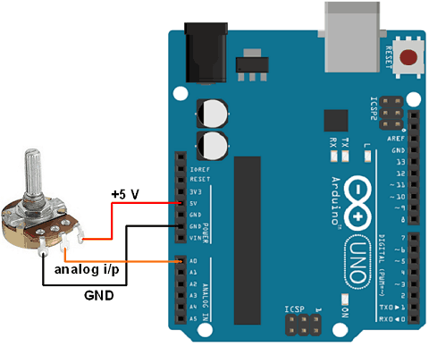

Slide 26
int sensorPin = A0; // input pin for the potentiometer
int digitalValue = 0;// variable to store the value coming from the sensor
void setup()
{
Serial.begin(9600);
}
void loop()
{
digitalValue = analogRead(sensorPin);// read the value from the analog channel
Serial.print("digital value = ");
Serial.println(digitalValue); //print digital value on serial monitor delay(1000);
}

Slide 27
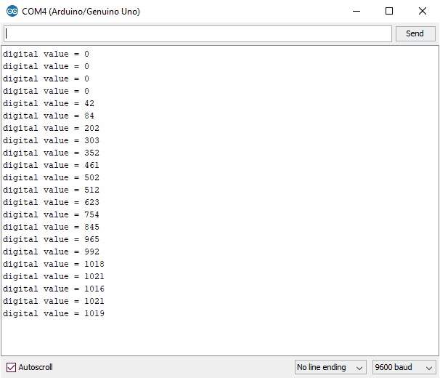
Note: If nothing is connected to analog input channel then the analogRead () function return the noisy fluctuating value.

Slide 28
Read Analog Voltage using Arduino Uno
As ADC provide digital output which is proportional to analog value. To know what is input analog value, we need to convert this digital value back to analog value through program. To convert this digital value to analog input voltage,
Aout = digital value * (Vref/2^n – 1)
e.g. digital value = 512 and ADC is 10-bit with 5V Vref. But, we want to know that for what analog voltage it is giving respective digital value. Then,
Aout = 512 * (5 V / 1023)
= 2.5 V

Slide 29
int sensorPin = A0; // select the input pin for the potentiometer
int digitalValue = 0; // variable to store the value coming from the sensor
float analogVoltage = 0.00;
void setup()
{
Serial.begin(9600);
}
void loop()
{
digitalValue = analogRead(sensorPin);// read the value from the analog channel
Serial.print("digital value = ");
Serial.print(digitalValue); //print digital value on serial monitor
//convert digital value to analog voltage
analogVoltage = (digitalValue * 5.00)/1023.00;
Serial.print(" analog voltage = ");
Serial.println(analogVoltage);
delay(1000);
}

Slide 30
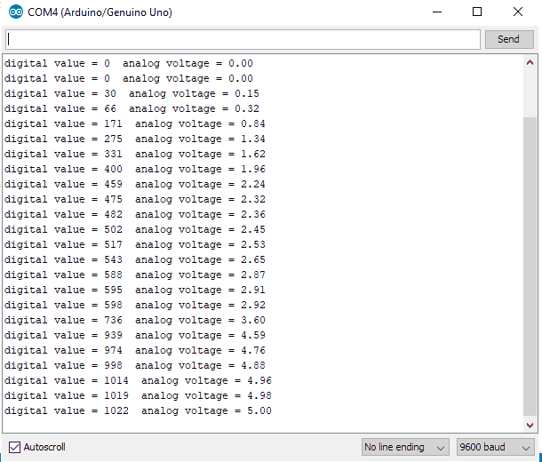

Slide 31
Analog I/O]
analogWrite()
Writes an analog value (PWM wave) to a pin. Can be used to light a LED at varying brightnesses or drive a motor at various speeds.
After a call to analogWrite(), the pin will generate a steady square wave of the specified duty cycle until the next call to analogWrite() (or a call to digitalRead() or digitalWrite() on the same pin).

Slide 32
Pulse Width Modulation (PWM) is a technique by which width of a pulse is varied while keeping the frequency of the wave constant. It is a method for generating an analog signal using a digital source.

Slide 33
A PWM signal consists of two main components that define its behaviour: a duty cycle and a frequency.
Duty Cycle of Signal
A period of a pulse consists of an ON cycle (5V) and an OFF cycle (0V). The fraction for which the signal is ON over a period is known as a duty cycle.
E.g. A pulse with a period of 10ms will remain ON (high) for 2ms.Therefore, duty cycle will be
D = 2ms / 10ms = 20%
Through PWM technique, we can control the power delivered to the load by using ON-OFF signal. The PWM signals can be used to control the speed of DC motors and to change the intensity of the LED.

Slide 34

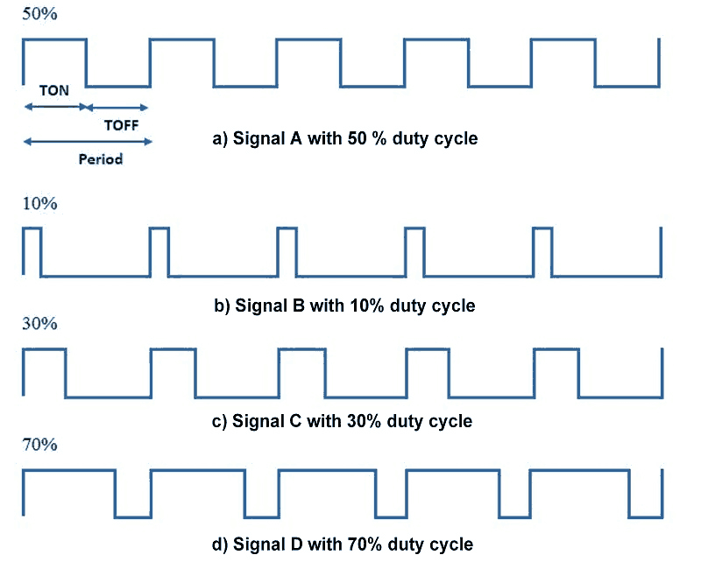

Slide 35
Frequency of Signal
The frequency of a signal determines how fast the PWM completes a cycle (i.e. 1000 Hz would be 1000 cycles per second) which means how fast it switches between ON (high) and OFF (low) states. By repeating this ON-OFF pattern at a fast-enough rate, and with a certain duty cycle, the output will appear to behave like a constant voltage analog signal when providing power to devices.
Example: If we want to create a 2V analog signal for a given digital source that can be either high (on) at 5V, or low (off) at 0V, we can use PWM with a duty cycle of 40%. It will provide output 5V for 40% of the time. If the digital signal is cycled fast enough, then the voltage seen at the output appears to be the average voltage. If the digital low is 0V (which is usually the case) then the average voltage can be calculated by taking the digital high voltage multiplied by the duty cycle, or 5V x 0.4 = 2V.

Slide 36
LED fading using Arduino PWM
int led = 6; // the PWM pin the LED is attached to
int brightness = 0; // how bright the LED is
int fadeAmount = 5; // how many points to fade the LED by
void setup()
{
pinMode(led, OUTPUT); // declare pwm pin to be an output:
}
void loop()
{
analogWrite(led, brightness); // set the brightness of led
// change the brightness for next time through the loop:
brightness = brightness + fadeAmount; // reverse the direction of
//the fading at the ends of the fade:
if (brightness <= 0 || brightness >= 255)
{
fadeAmount = -fadeAmount;
}
delay(30); // wait for 30 milliseconds to see the dimming effect
}

Slide 37
The PWM pins are 8-bit pins, terming that you can set the duty cycle somewhere between 0 -255.
The duty cycle is described as the amount time the signal switches between ON and OFF condition. It is mainly written in percentage.
If the signal remains turned ON half of the total duty cycle and OFF in another half, then the duty cycle will be 50%.
The analogWrite comes handy when you plan to control the motor speed or the intensity of any LED.
The value you write on the PWM pins will control the speed.
For example, if you intend to run the motor at full speed, you will set the value 255 i.e. the maximum value it can handle that will ultimately run the motor at full speed.

Slide 38
Similarly, setting value as “0” will be sending no signal and motor won’t start.
And if the motor requires to be run at half speed, then you will set the value 127 or 128 – half of the maximum value that will cause the motor to be running at half speed.
Arduino Uno comes with PWM pins available on digital pin number 3,5,6 and 9,10,11

Slide 39
analogWrite(int pin, int value);
where:
“pin” is the pin number you are targeting.
“value” is the duty cycle that can be set anywhere between 0 to 255 where former indicates the OFF condition and later indicates the system is running at full speed.
Example
analogWrite(10, 175);

Slide 40
int PWMControl= 6;
int PWM_Input = A0;
int PWM_Value = 0;
void setup()
{
pinMode(PWMControl, OUTPUT);
pinMode(PWM_Input, INPUT);
Serial.begin(9600);
}
void loop()
{
PWM_Value = analogRead(PWM_Input);
PWM_Value = map(PWM_Value, 0, 1023, 0, 255); analogWrite(PWMControl, PWM_Value);
}

